Slide 1
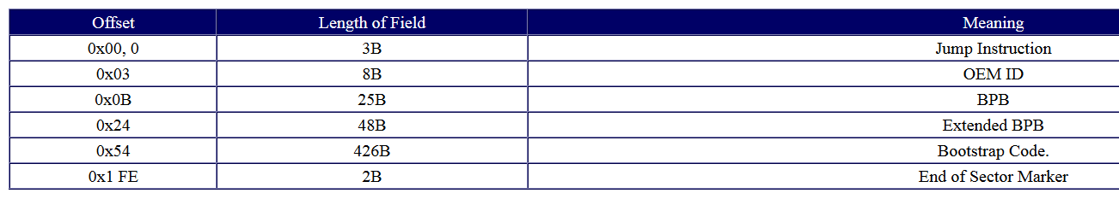
NTFS - VBR

Slide 2
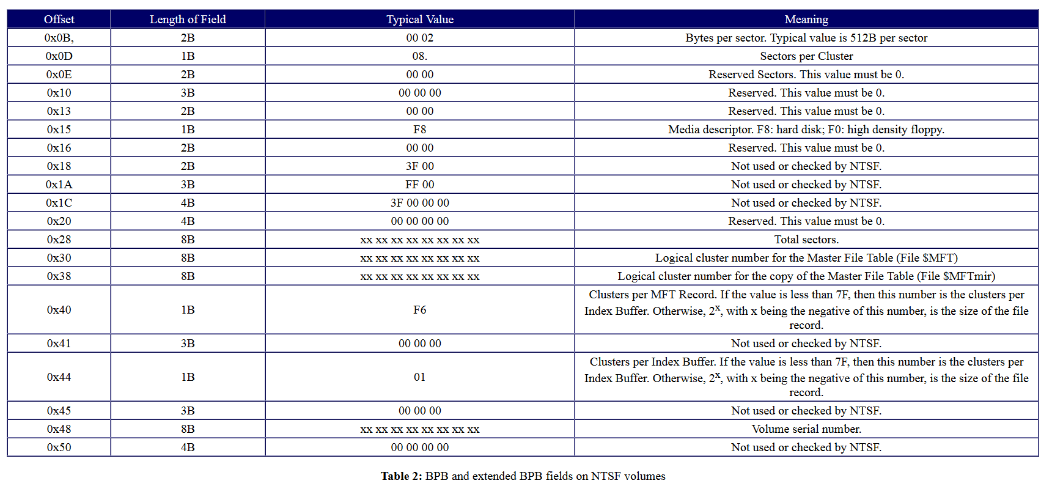
NTFS - VBR

Slide 3
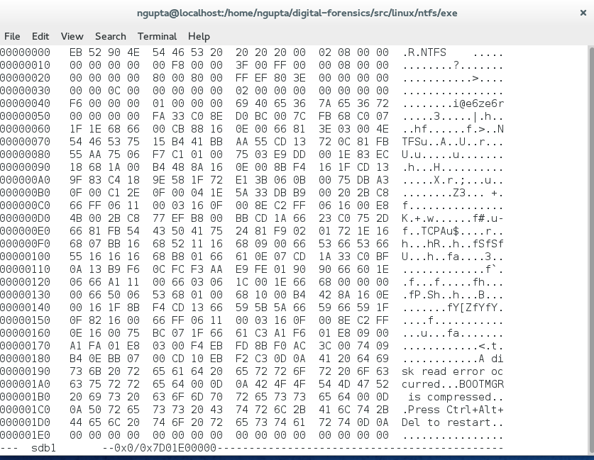
NTFS
Size of each sector – default is 512,
location 0x0b size 2 bytes = 0x0200 = 512

Slide 4
NTFS
Sectors per cluster – default is 4096,
location 0x0d size 1 bytes = 0x08 = 512 * 8 = 4096

Slide 5
NTFS
Location of MFT, location 0x30 size 8 bytes = 0x0c0000 (cluster #)
Byte address = 0xc0000 * 0x 1000 = 0xc0000000

Slide 6
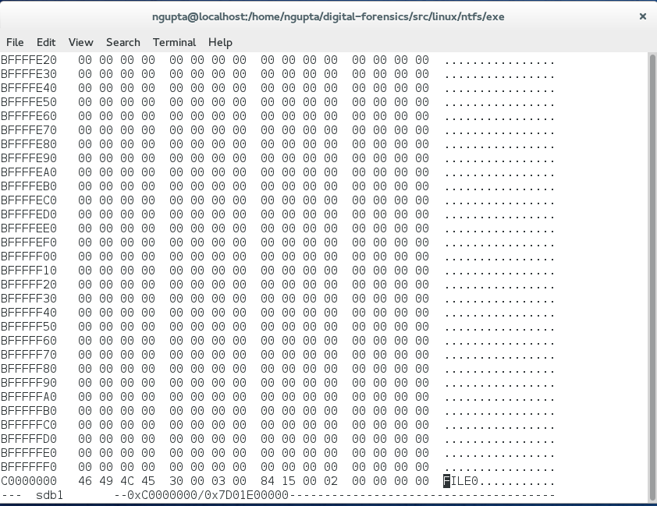
NTFS
Location of MFT, location 0x30 size 8 bytes = 0x0c0000 (cluster #)
Byte address = 0xc0000 * 0x 1000 = 0xc0000000

Slide 7
NTFS
Location of Mirror MFT, location 0x30 size 8 bytes = 0x02 (cluster #)
Byte address = 0x02 * 0x 1000 = 0x2000

Slide 8
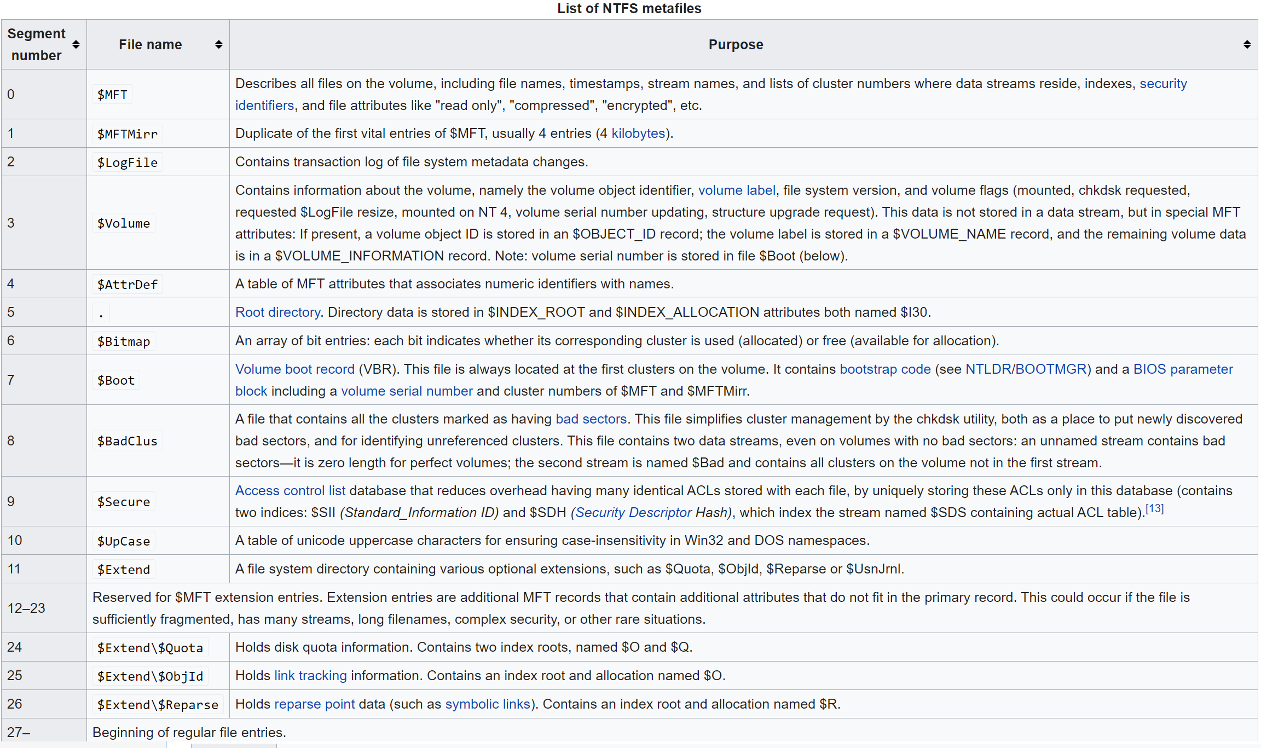
NTFS System files

Slide 9
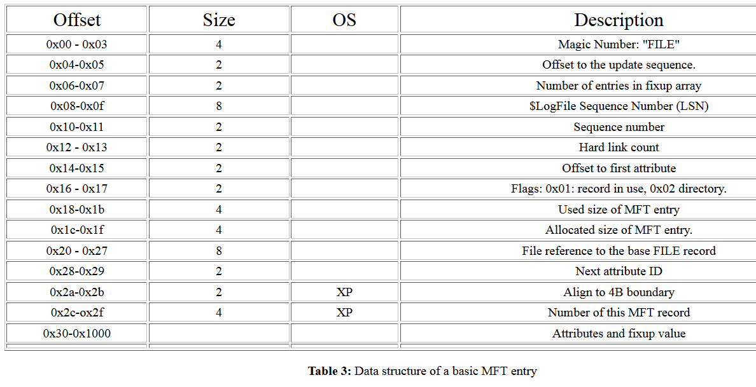
NTFS – MFT header

Slide 10
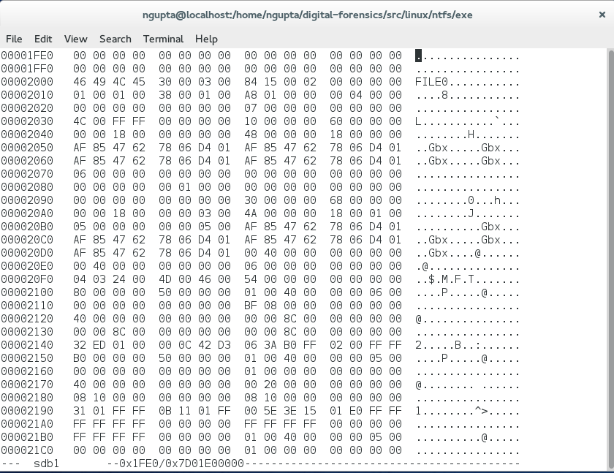
NTFS
MFT – magic number - FILE

Slide 11
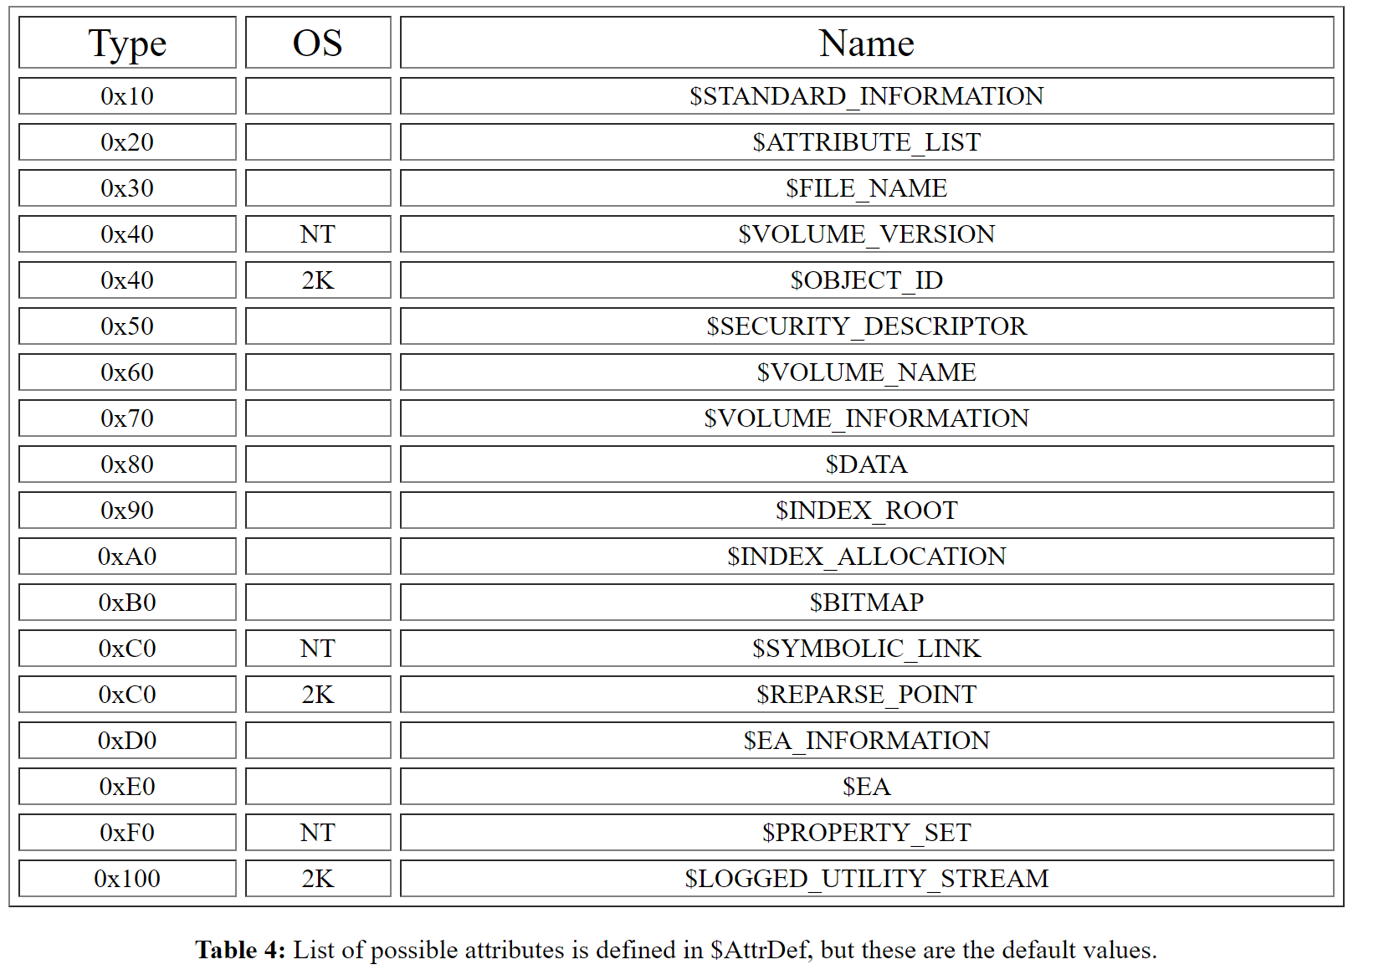
Attribute List

Slide 12
NTFS
MFT – location of first attribute – 0x38

Slide 13
NTFS
MFT – first attribute – 0x10 (standard Info)

Slide 14
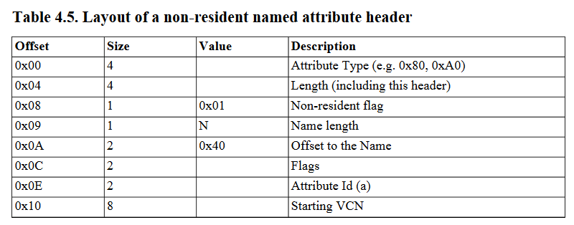
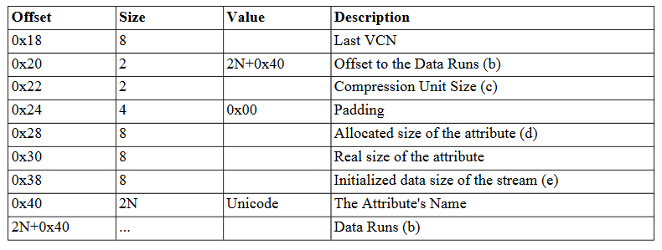
Attribute Header

Slide 15
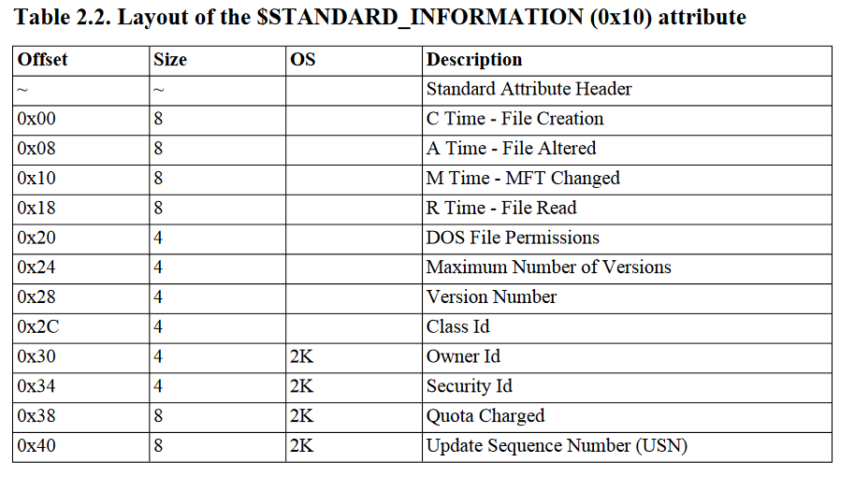
NTFS – 0x10

Slide 16
NTFS
MFT – length first attribute – 0x60

Slide 17
NTFS
MFT – next attribute – 0x30 (location of last + length – 0x38 + 0x60 = 0x98)
contains name of the file - $MFT

Slide 18
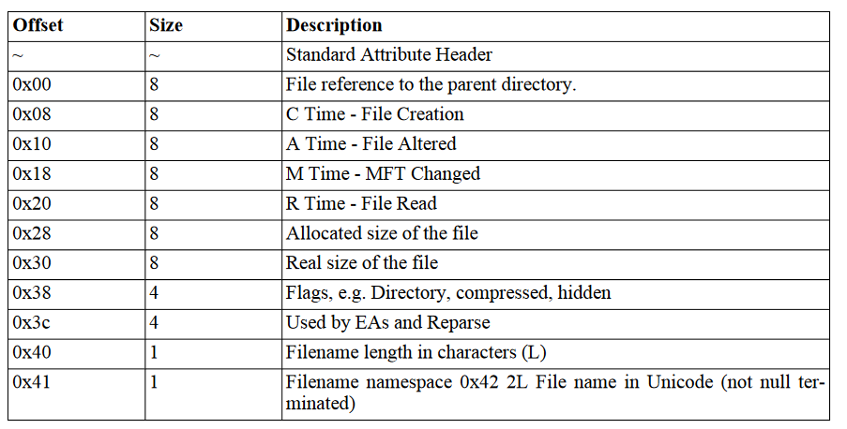
0x30

Slide 19
NTFS
MFT – length of 0x30 attribute – 0x68

Slide 20
NTFS
MFT – 0x30 – after the header of 24 bytes
At start of the attribute is reference to parent entry for the file – 6 bytes

Slide 21
NTFS
MFT – length of 0x30 attribute header – 24 bytes
Length of file name - 4

Slide 22
NTFS
MFT – length of 0x30 attribute header – 24 bytes
file name - $MFT

Slide 23
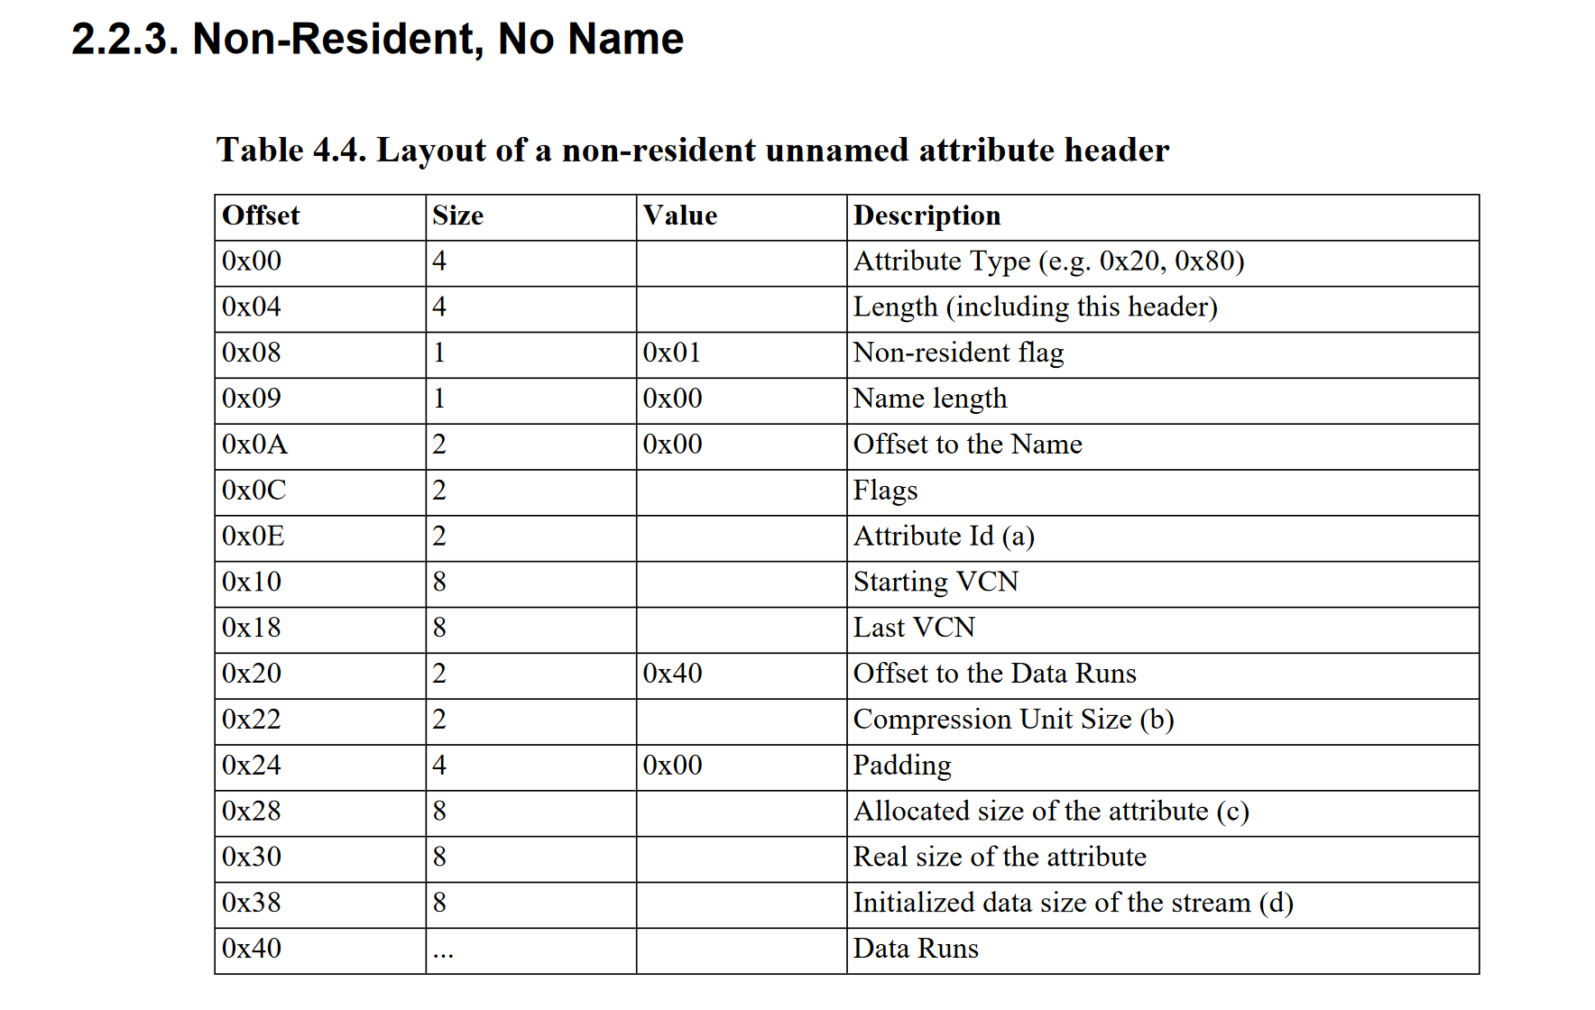

Slide 24
NTFS
MFT – next attribute – 0x80 - DATA
(location of last + length – 0x98 + 0x68 = 0x100)

Slide 25
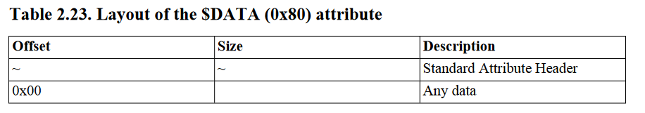
NTFS – 0x80

Slide 26
NTFS
DATA Attribute – length of 0x80 attribute – 0x50

Slide 27
NTFS
DATA Attribute – non-resident flag - 01

Slide 28
NTFS
DATA Attribute – offset to Data run – 0x40

Slide 29
NTFS
DATA Attribute – Data run – 0x40

Slide 30
NTFS
DATA Attribute – Data run – 0x32
3 is size of the cluster offset field; 2 is the size of the length of contiguous clusters.
Cluster offset is 0x 0c0000; number of contiguous clusters is 0x 01ed

Slide 31
NTFS
DATA Attribute – Data run – second 0x42
4 is size of the cluster offset field; 2 is the size of the length of contiguous clusters.
Cluster offset is 0x02ffb03a; number of contiguous clusters is 0x06D3

Slide 32
NTFS
DATA Attribute – Data run – 0x32
3 is size of the cluster offset field; 2 is the size of the length of contiguous clusters.
Cluster offset is 0x 0c0000; number of contiguous clusters is 0x 01ed
We again confirmed that entries start at cluster 0xc0000
In bytes = 0xc0000 * 1000 = 0xc0000000
Root directory is entry 5.
Each entry is 1000 bytes (0x400)
So root entry should start at 0xc0000000 + 0x1400 = 0xc0001400

Slide 33
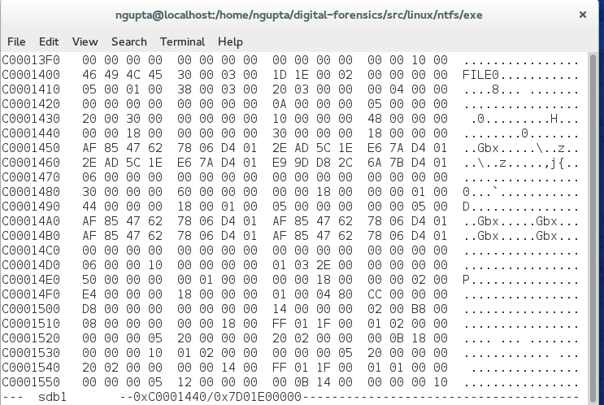
Root entry

Slide 34
Root – directory entry
First Attribute at offset 0x38 is 0x30 (standard Info)

Slide 35
Root – directory entry
First Attribute at offset 0x38 is 0x10 (standard Info), size is 0x48

Slide 36
Root – directory entry
Second Attribute at offset 0x38 + 0x48 = 0x80
is 0x30 (FILE NAME)

Slide 37
Root – directory entry
Second Attribute at offset 0x38 + 0x48 = 0x80
is 0x30 (FILE NAME), size is 60

Slide 38
0x30

Slide 39
Root directory entry
Check the resident flag – 0x00 - resident

Slide 40
Root directory entry
Check the resident flag – 0x00 - resident.
Check name info – 0x00 (no name) Get resident no name header info

Slide 41
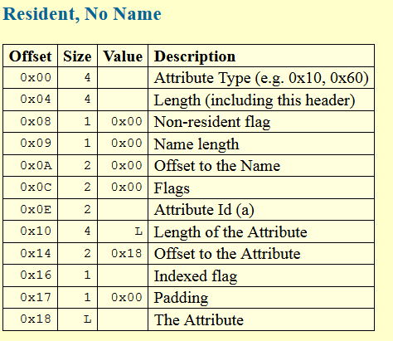
Resident no name Attribute header

Slide 42
Root directory entry
Header size is 0x18. File name info start at 0x18 offset.
First field is index of parent directory is 0x5 (itself)

Slide 43
Root directory entry
Header size is 0x18. File name info start at 0x18 offset.
File name length field is at 0x40 + 0x18 – 0x1 so length is 1 char

Slide 44
Root directory entry
Header size is 0x18. File name info start at 0x18 offset.
Filename namespace is 0x3 - Win32 & DOS names

Slide 45
Root directory entry
Header size is 0x18. File name info start at 0x18 offset.
File name is 0x2e (ASCII code for . (DOT) )

Slide 46
Root – directory entry
third Attribute at offset 0x80 + 0x60 = 0xE0
is 0x50 (SECURITY DESCRIPTOR),

Slide 47
Root – directory entry
third Attribute at offset 0x80 + 0x60 = 0xE0
is 0x50 (SECURITY DESCRIPTOR), size is 100

Slide 48
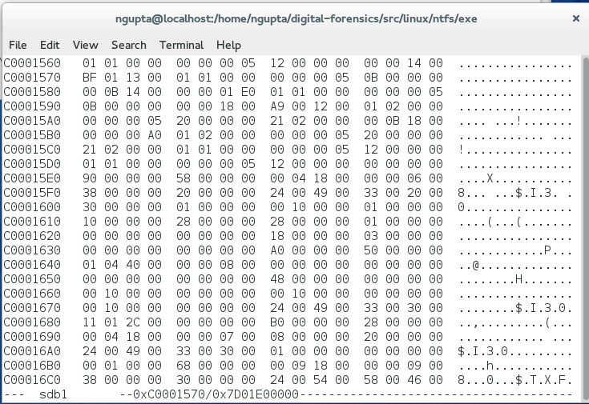
Root – directory entry
Fourth Attribute at offset 0xE0 + 0x100 = 0x1E0
is 0x90 (INDEX ROOT),

Slide 49
Root – directory entry
Fourth Attribute at offset 0xE0 + 0x100 = 0x1E0
is 0x90 (INDEX ROOT), size = 0x58

Slide 50
Root – directory entry
is 0x90 (INDEX ROOT), size = 0x58, resident

Slide 51
Root – directory entry
is 0x90 (INDEX ROOT), size = 0x58, resident; name length = 04

Slide 52
Root – directory entry
is 0x90 (INDEX ROOT), size = 0x58, resident; name length = 04,
Offset to name 0x18

Slide 53
Root – directory entry
is 0x90 (INDEX ROOT), size = 0x58, resident; name length = 04,
Offset to name 0x18, flags (normal file);

Slide 54
Root – directory entry
is 0x90 (INDEX ROOT), size = 0x58, resident; name length = 04,
Offset to name 0x18, flags (normal file);Attribute id – 0x06

Slide 55
Root – directory entry
is 0x90 (INDEX ROOT), size = 0x58, resident; name length = 04, Offset to name 0x18, flags (normal file);Attribute id – 0x06, attr len = 0x38

Slide 56
Root – directory entry
is 0x90 (INDEX ROOT), size = 0x58, resident; name length = 04, Offset to name 0x18, flags (normal file);Attribute id – 0x06, attr len = 0x38, offset to attribute – name offset + name length*2 = 0x20.

Slide 57
Root – directory entry
is 0x90 (INDEX ROOT), size = 0x58, resident; name length = 04, Offset to name 0x18, flags (normal file);Attribute id – 0x06, attr len = 0x38, offset to attribute – name offset + name length*2 = 0x20.

Slide 58
Root – directory entry
is 0x90 (INDEX ROOT), size = 0x58, resident; name length = 04, Offset to name 0x18, flags (normal file);Attribute id – 0x06, attr len = 0x38, offset to attribute – name offset + name length*2 = 0x20.n name = $I30

Slide 59
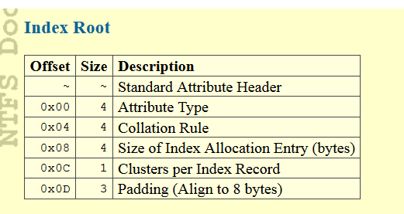
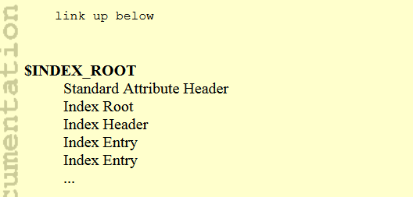
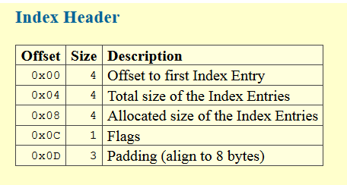

Slide 60
Index root
Attribute type = 0x30 (file name);

Slide 61
Index root
Attribute type = 0x30 (file name); coalition rule – 01 (filename ordering);

Slide 62
Index root
Attribute type = 0x30 (file name); coalition rule – 01 (filename ordering);, index entry size 0100 0 4096 bytes.

Slide 63
Index root
Attribute type = 0x30 (file name); coalition rule – 01 (filename ordering);, index entry size 0100 0 4096 bytes. ; clusters per index record;

Slide 64
Index root
Attribute type = 0x30 (file name); coalition rule – 01 (filename ordering);, index entry size 0100 0 4096 bytes. ; 01 clusters per index record; 000000 padding.

Slide 65
Index header
20 – offset for first index entry.

Slide 66
Index header
0x20 – offset for first index entry. 0x28 index entry total size

Slide 67
Index header
0x20 – offset for first index entry. 0x28 index entry total size; 0x28 index entry allocated size

Slide 68
Index header
0x20 – offset for first index entry. 0x28 index entry total size; 0x28 index entry allocated size; 01 – flag indicates does not fit in index, external allocation needed.

Slide 69
Index header
0x20 – offset for first index entry. 0x28 index entry total size; 0x28 index entry allocated size; 01 – flag indicates does not fit in index, external allocation needed.
00 00 00 padding

Slide 70
Data – Non Resident – no name

Slide 71
Flag indicates non resident

Slide 72
Offset to data run is 0x40

Slide 73
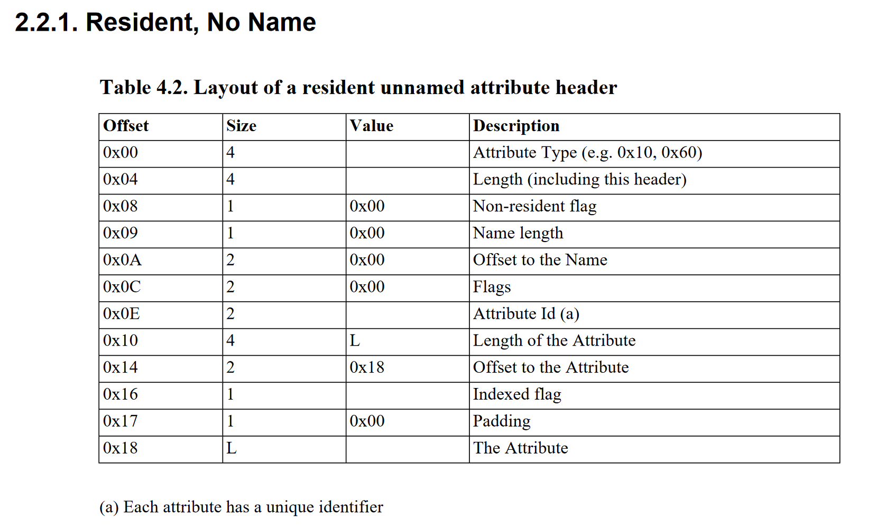
Resident No Name

